Slide 1
Introduction to Enterprise Application Development

Slide 2
What is an enterprise application?
Software that performs business functions such as accounting, customer information management, sales and so on
Aims to improve the organisation’s performance

Slide 3
What is an enterprise application?
Software application for the enterprises of today…and tomorrow…
  Need for rapid scalability (both in terms of volume and geographical spread)
  Need to accommodate multiple types of device access
  Need to integrate with diverse software applications
  Need to be very change-friendly
  High degree of security reliability and performance

Slide 4
Enterprise application n-tier architecture
Browser
firewall
Application Client
Services
Presentation logic
Business Logic
XML
documents
DB

Slide 5
What is a web application?
Client accesses applications using a browser.
Client typically requests for a static or dynamic resource/page from a server connected to the internet. This server is a web server.
The client typically gets back HTML page as response that can view in the browser. Further interaction with the server can happen using the HTML page.

Slide 6
Static and Dynamic resource/page
Static pages/resources are the files that are pre-created in a particular path in the web server.
Dynamic pages are created by the application on the fly.

Slide 7
Web server
Request for a static resources is met by the web server.
The web server understands HTTP protocol.
Example: Apache web server.

Slide 8
Application server
Request for a dynamic resource is met by application server.
The web server which can run web application is an application server.
Example: Websphere Application Server from IBM

Slide 9
HTTP Protocol
An application level protocol ( generally implemented over TCP/IP) used to transfer information between the web clients and web applications.
It provides a set of rules that computers use to communicate over the internet.

Slide 10
HTTP Protocol
Communication is done by sending packets.
The packet structure should be is defined by the protocol.
Packets are request and response packet.
Older HTTP versions was stateless implies that after one cycle of request-response the connection between the client and the web server is lost.
HTTP 1.1 is not stateless.
Most common HTTP request methods: GET and POST

Slide 11
HTTP Protocol
Older HTTP versions were stateless meaning:
  after one cycle of request-response the connection between the client and the web server is lost.
HTTP 1.1 is not stateless.
Most common HTTP request methods: GET and POST

Slide 12
HTTP and Statelessness
opening connection to the requested URL
Request
Response
Client
closing connection to the requested URL
Web Server

Slide 13
The GET request method
Used for accessing static resources such as HTML pages or images.
Example: requesting for a page www.yahoo.com

Slide 14
The GET request method
Can also be used to retrieve information that is formed dynamically ( example: page generated by the application in a response to a specific user query).
Form tag assumes GET method when method attribute is not specified.
Example: www.mySite.com/index.do?city=Bangalore

Slide 15
A sample GET Packet
GET /mywebdir/index.do?city=Bangalore HTTP/1.1
Host:www.mySite.com
User-Agent:Mozilla/5.0…
Accept: text/xml,application/xml, text/html, image/gif
Accept-Language: en-us
Accept-Encoding: gzip, deflate
Keep-Alive: 300
Connection: keep-alive
Request Header

Slide 16
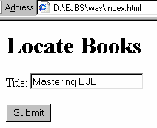
<html>
<head>
<title>Book list</title>
</head>
<body>
<h1>Locate Books</h1>
<form name=“findBook" method=“get" action="FindBook">
Title:
<input name="title" type="text"><br><br>
<input type="submit" name="Submit" value="Submit">
</form>
</body>
</html>
optional
Query String
Request goes to the application as:
http://myWeb/FindBook?title=“Mastering%20EJB”
URL: Uniform Resource Locator

Slide 17
The POST Request
This method is used to send large amount of data to the server.
It is commonly used for accessing dynamic resources.
Data is sent within the body of the request.
  If data such as password is transmitted, the post method is preferred.

Slide 18
A sample POST Packet
POST /mywebdir/index.do HTTP/1.1
Host:www.mySite.com
User-Agent:Mozilla/5.0…
Accept: text/xml,application/xml, text/html, image/gif
Accept-Language: en-us
Accept-Encoding: gzip, deflate
Keep-Alive: 300
Connection: keep-alive
city=Bangalore&state=Karnataka
Request Header
Request Body

Slide 19
A sample response packet
Status code which indicates successful request acceptance
HTTP/1.1 200 OK
Set-Cookie:JSESSIONID=7277272818;Path=/xyz
Content-Type: text/html
Content-Length:230
Date: Sun, 1 Apr 2007 13:45:30 GMT
Server: Apache Server/1.1
Connection:close
<html>
…
</html>
Response Header
Response Body

Slide 20
Status codes
Status Code | Type | Description
1XX | Information | Request received, continuing to process
2XX | Success | The was successfully received and accepted
3XX | Redirection | Further action must be in order to complete the request
4XX | Client Error | Request cannot be fulfilled because of error in client side
5XX | Server Error | Request cannot be fulfilled because of error in server side

Slide 21
Java Platform, Enterprise Edition
JEE is a powerful collection of technologies that sit on top of Java2 Standard Edition (J2SE) environment.
It provides cross-platform compatibility for both application and application server.
The JEE architecture is managed by Sun Microsystems with the help and support of many active industry partners.
JEE technology is used to build used to build enterprise application.

Slide 22
JEE technologies: Foundation
Java Platform, Enterprise Edition 5

Slide 23
JEE technologies: Web Services Technologies
Java API for XML-based Web Services (JAX-WS)
Java API for XML-based RPC (JAX-RPC)
Java Architecture for XML Binding
SOAP with Attachments API for Java (SAAJ)
Streaming API for XML
Web Service Metadata for the Java Platform

Slide 24
JEE technologies: Web Application Technologies
JavaServer Faces (JSF)
JavaServer Pages (JSP)
JavaServer Pages Standard Tag Library
Java Servlet

Slide 25
JEE technologies: Enterprise Application Technologies
Common Annotations for the Java platform
Enterprise Java Beans (EJB)
J2EE Connector Architecture
JavaBeans Activation Framework (JAF)
JavaMail
Java Message Service API
Java Persistence API
Java Transaction API (JTA)

Slide 26
JEE technologies: Management and Security Technologies
J2EE Application Deployment
J2EE Management
Java Authorisation Contract for Containers

Slide 27
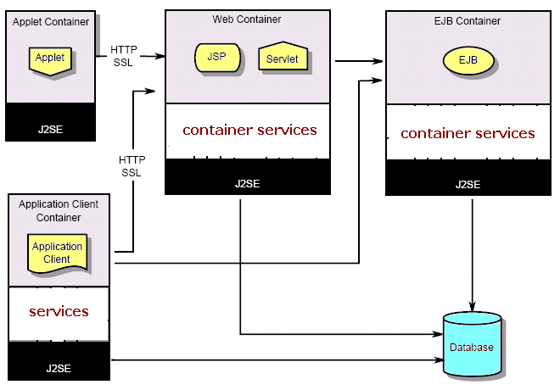
J2EE Architecture
Our Focus !
Notes:
Containers provide the runtime support for the application components.

Slide 28
Advantages of JEE
Helps in creating applications that meet the needs of modern enterprises (we looked at this earlier)
Simple to develop application
    Easy to communication with the server
    Declarative security, transaction
Application server independence
    Application developed can be deployed in application servers developed by different vendors
Flexible security model
    Authentication system defined by OS or application can be used based on the requirement

Slide 29
Java web applications
Java web applications are made up of JavaServer Pages (JSPs), Servlets and static resources such as HTML pages, images etc
The Web container is used to host these web components

Slide 30
Java web applications
Enterprise Java applications have EJBs as well
The EJB container is used to host EJBs.
Web Server + Web container + EJB container = Enterprise Application Server

